Slide 1


Slide 2


All the fun innovative ideas that make up this unique proposal were devised by the hardworking and dynamic team behind Vero.
The contents in this proposal may not be executed without the written approval of Vero. Thank you!

Slide 3
Monthly
Performance Review
Aug-2024 | By Insights IQ

Slide 4



AGENDA
01
Executive Summary
02
Brand Performance
03
Brand Audit

Slide 5
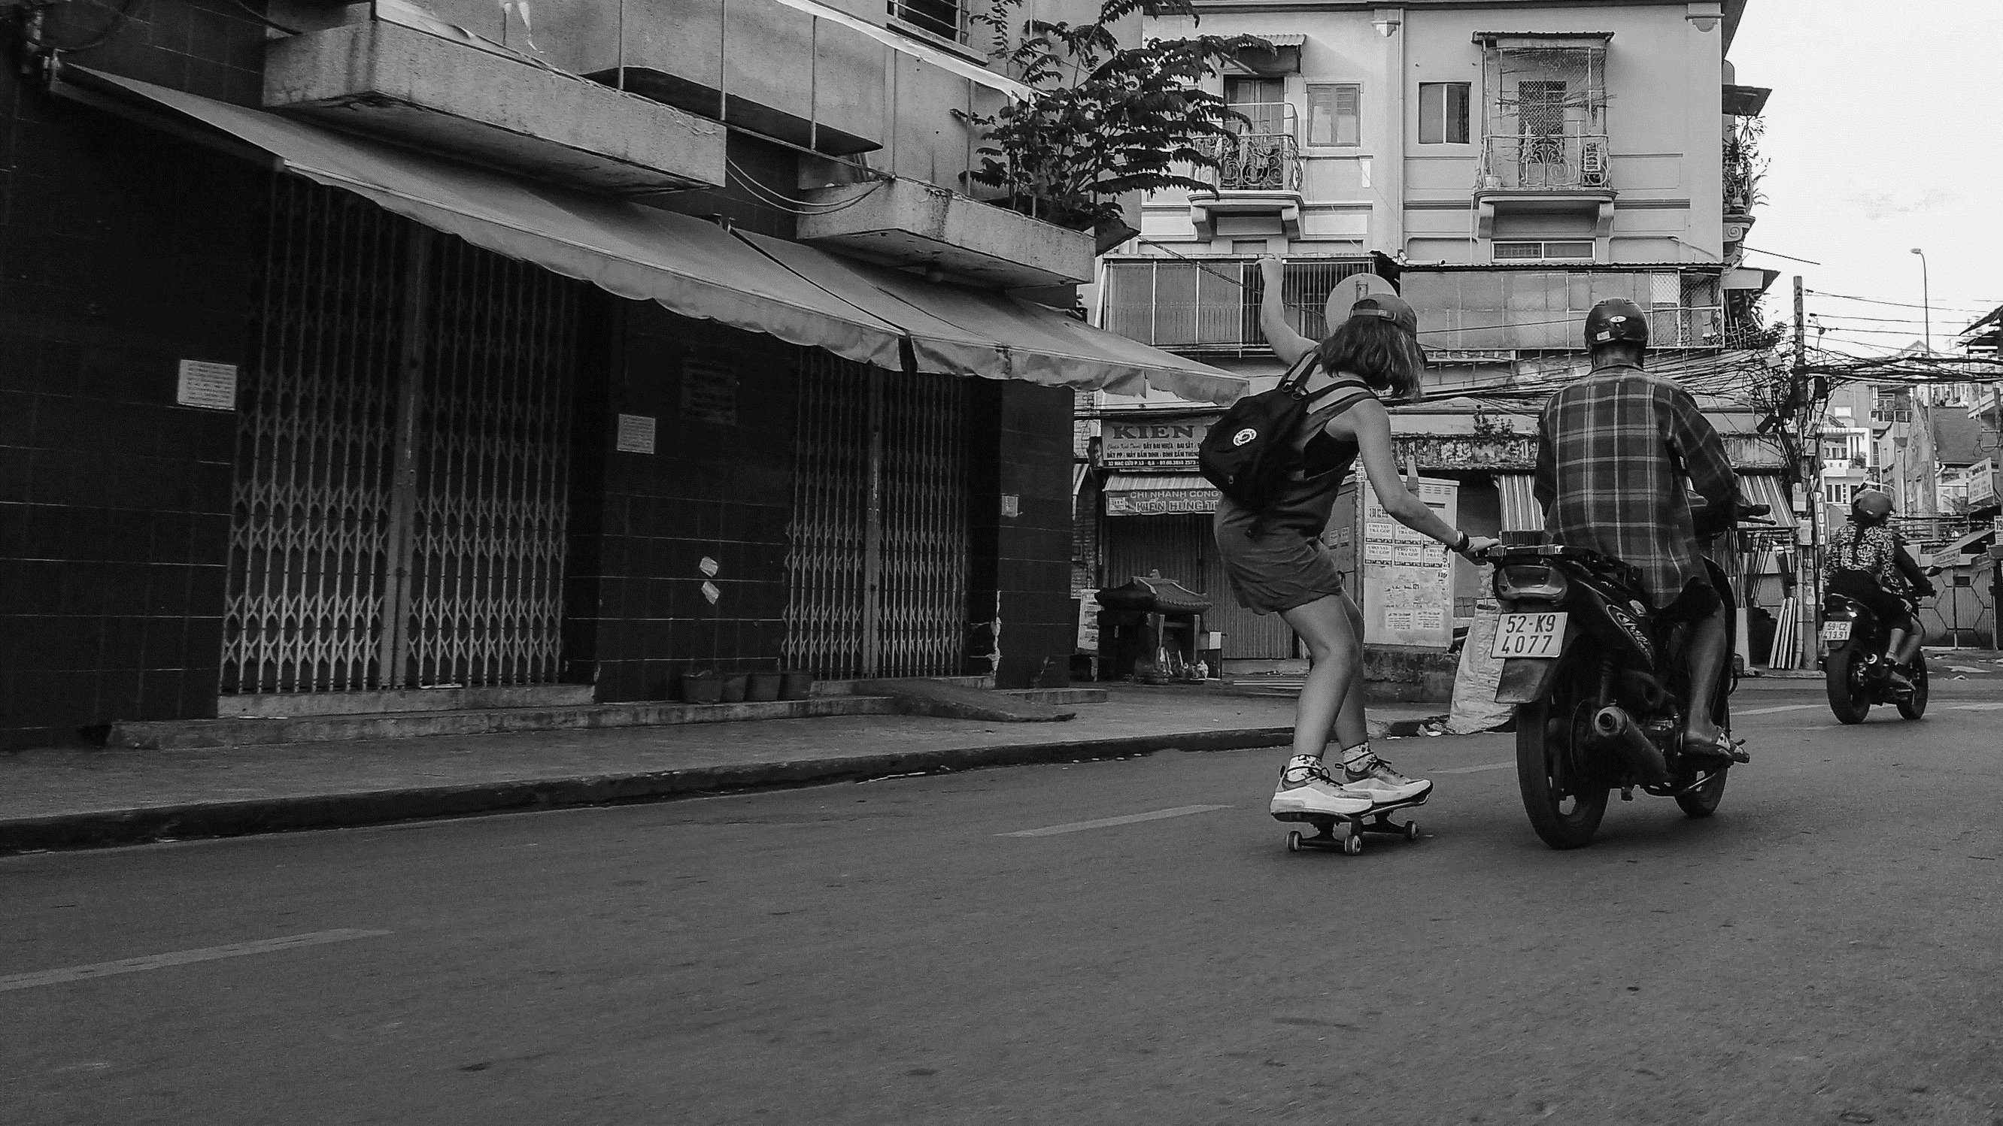
BRAND PERFORMANCE

Slide 6
Title 1
Sub-title
Key findings:
XXXX

Slide 7

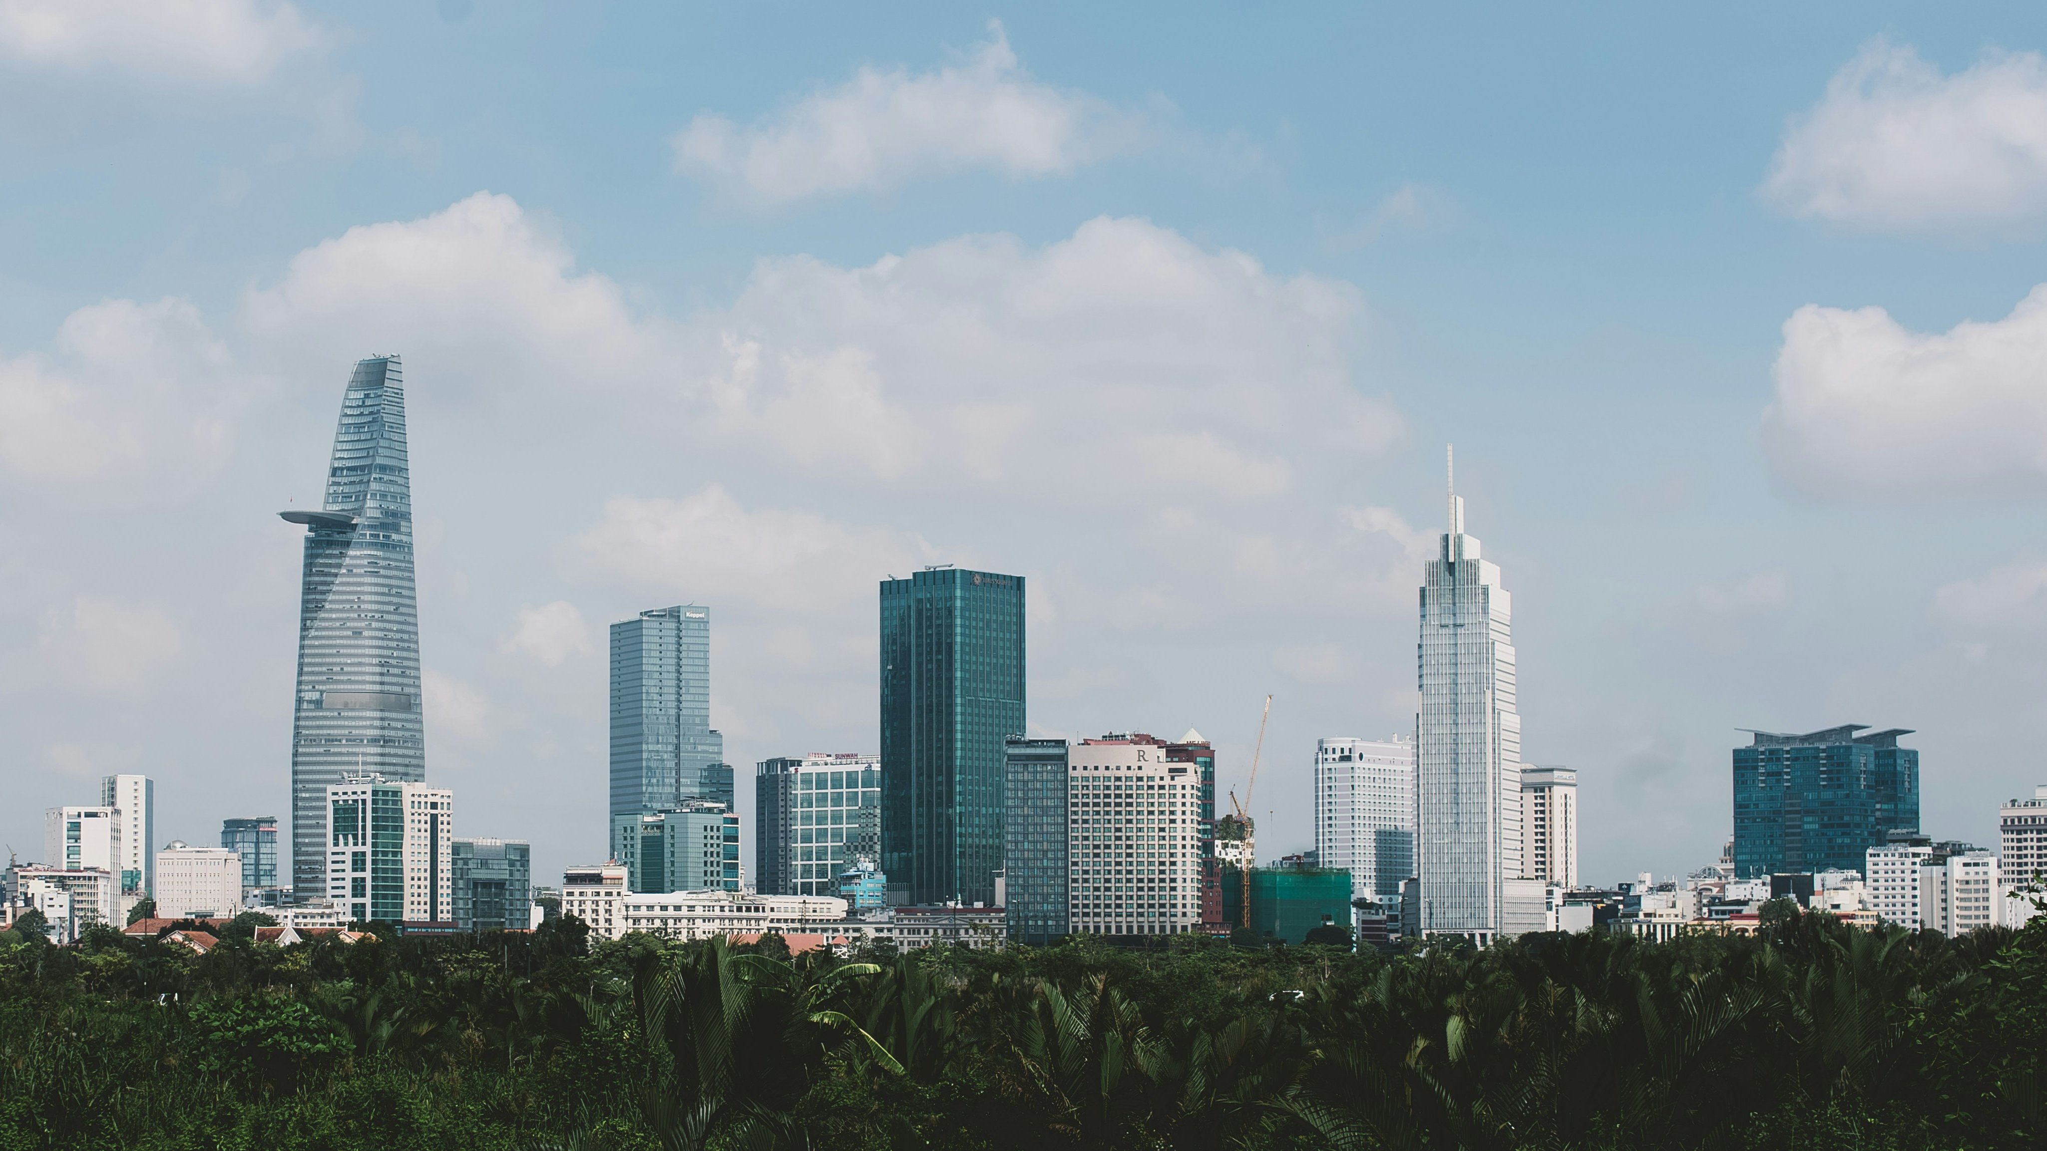
BRAND AUDIT

Slide 8
Title 1
Sub-title
Key findings:
XXXX

Slide 9
Title 1
Sub-title
Key findings:
XXXX

Slide 10
Key Takeaways
Dummy Data
1
2
3
4
ABC
DEF
XYZ
EFG
Key point 1
Key point 2
Key point 3
Key point 4

Slide 11
Strategic Recommendations
Dummy Data
1
2
3
4
Leverage Influencer Partnerships:
Boost Social Media Presence:
Brand offerings through IMC approach:
Enhance Local Media Relations:
Key point 1
Key point 2
Key point 3
Key point 1
Key point 2
Key point 3
Key point 1
Key point 2
Key point 3
Key point 1
Key point 2
Key point 3

Slide 12
Thank you

Slide 13
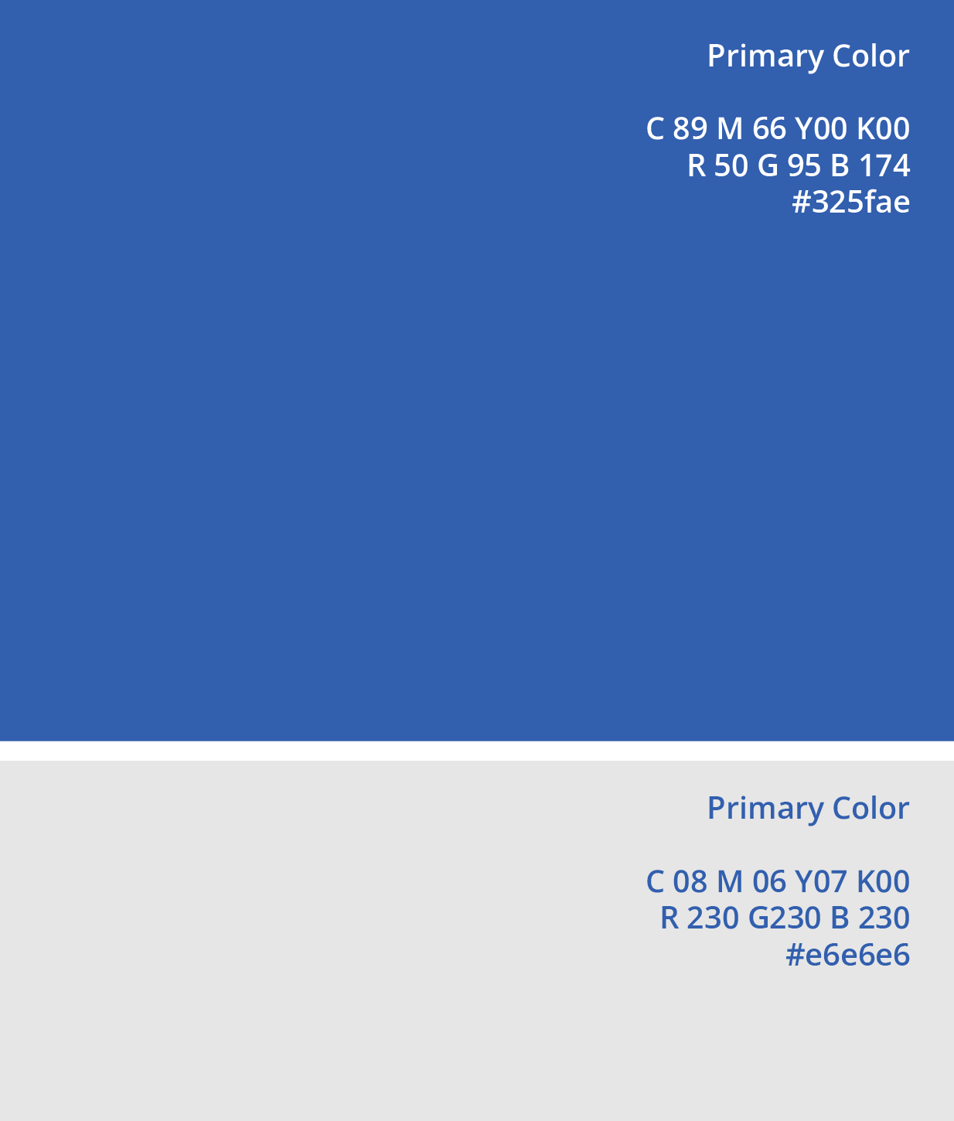


COLOURS
MODERATE BLUE
PRIMARY COLOURS
The light blue represents both youthful, open and trust. It evokes a feeling of how good things come to reality with the enjoyment in every single work.
The new 2 primary colours represent the brand that is refreshing, open, full of energy but not losing the professional and trustworthy core value.
MODERATE BLUE
VERY LIGHT GREY
Light grey brings the relaxing and soothing feelings with the meaning of neutrality and balance.
VERY LIGHT GREY

Slide 14
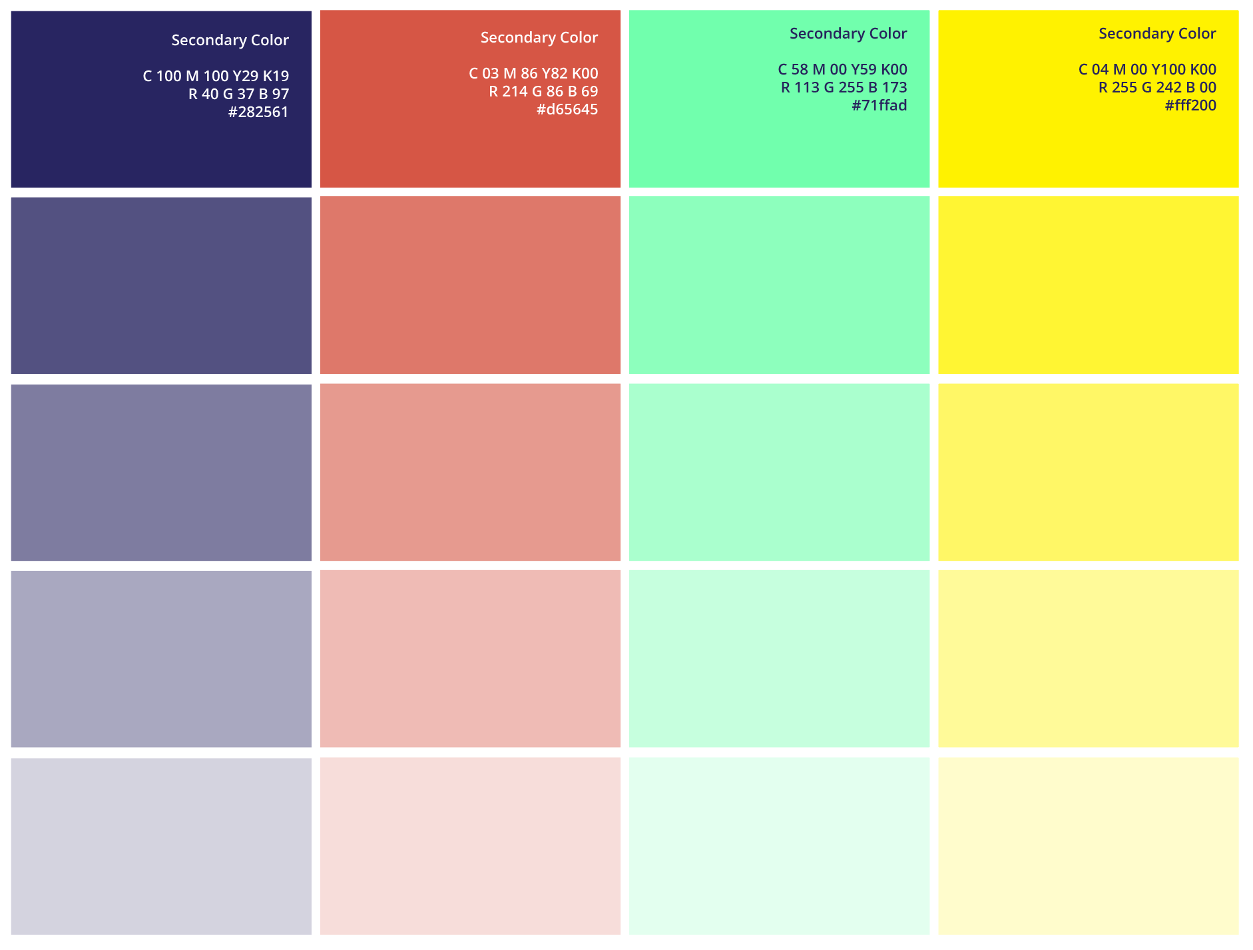
COLOURS
SECONDARY COLOUR
Variation colours are created to bring the diversity to the brand assets.
*Secondary colours must not be used independently. Only use to combine with other colours or apply transparent effect to make gradients.
MODERATE BLUE

Slide 15





COLOURS
Analogous
By combining Primary Colours and Secondary Colours, we have a set of gradients. Analogous Set is combined of colours in a row of tone.
Complementary
Complementary Colours are made of 2 or many contrast colours that make the gradients more vibrant.

Slide 16









SHAPES
MAIN BRAND VISUAL
GOVERNMENT ADVOCACY

Slide 17










SHAPES
BRAND COMMUNICATIONS
EVENT ACTIVATION

Slide 18




SHAPES
AI POWERED PR

Slide 20


